Slide 1



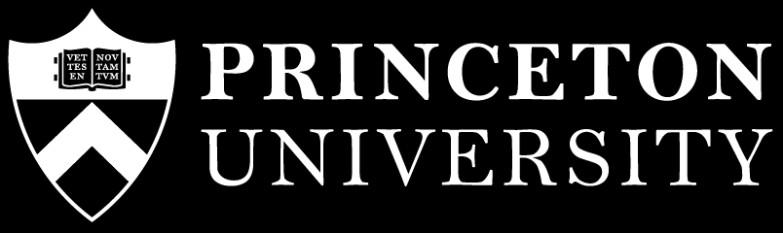
Low Pass Filter-Based Switch Buffer Sharing for Datacenters with RDMA and TCP Traffic
Vamsi Addanki, Wei Bai, Stefan Schmid, Maria Apostolaki
Notes:
Hi again. Thanks for staying through the session. I will be presenting Reverie. In this work, we tackle the buffer sharing problem in the context of Datacenters that serve a mix of RDMA and TCP traffic. This is a joint work with Wei Bai from Microsoft (who is now at NVIDIA), Stefan Schmid, my PhD advisor at TU Berlin, and Maria Apostolaki from Princeton.

Slide 2
Traditional Datacenter Networking
TCP-based applications
Host-networking consumes CPU clock cycles (a lot!!)
Loss-tolerant traffic
Notes:
Traditional datacenter networking involves TCP-based applications, and the host-networking consumes a lot of CPU clock cycles. The traffic is usually loss-tolerant.

Slide 3
Modern Datacenter Networking
TCP-based applications
RDMA-based applications
Host-networking consumes CPU clock cycles (a lot!!)
Host networking is offloaded to the NIC
NIC implements the entire networking stack
Loss-tolerant traffic
Lossless traffic
Requires Priority Flow Control (PFC)
Notes:
In contrast, modern datacenter networking involves RDMA-based applications, host networking is offloaded to the Network interface Card that implements the entire networking stack. In particular, traffic is lossless, and this requires Priority Flow Control at each hop in the network.

Slide 4
Production Datacenter Networks
A mix of RDMA and TCP traffic
Switches use shared buffers
Both RDMA and TCP share the limited buffer space at each switch in the network

Slide 5
Switch Buffer Sharing with TCP
Input Ports
Switch
(Shared buffer)
Output Ports

Slide 6
Switch Buffer Sharing with TCP
TCP Flow
Input Ports
Output Ports

Slide 7
Switch Buffer Sharing with TCP
TCP Flow
Input Ports
Egress queue
Output Ports

Slide 8
Switch Buffer Sharing with TCP
TCP Flow
Input Ports
Egress queue
Output Ports

Slide 9
Switch Buffer Sharing with TCP
TCP Flow
Input Ports
Packet drops
Egress queue
Output Ports

Slide 10
Switch Buffer Sharing with TCP
Based on egress queue lengths and packet drops
A buffer sharing algorithm assigns a threshold for each egress queue in a switch
Packet accepted: Threshold > Queue length (egress)
Packet dropped: Threshold < Queue length (egress)

Slide 11
Switch Buffer Sharing with RDMA
RDMA Flow
Input Ports
Output Ports

Slide 12
Switch Buffer Sharing with RDMA
RDMA Flow
Input Ports
Ingress queues
Output Ports

Slide 13
Switch Buffer Sharing with RDMA
RDMA Flow
Input Ports
Ingress queues
Output Ports

Slide 14
Switch Buffer Sharing with RDMA
PFC Pause
Input Ports
Ingress queues
Output Ports

Slide 15
Switch Buffer Sharing with RDMA
Input Ports
Ingress queues
Output Ports

Slide 16
Switch Buffer Sharing with RDMA
Input Ports
Ingress queues
Output Ports

Slide 17
Switch Buffer Sharing with RDMA
Input Ports
Ingress queues
Output Ports

Slide 18
Switch Buffer Sharing with RDMA
PFC Resume
Input Ports
Ingress queues
Output Ports

Slide 19
Switch Buffer Sharing with RDMA
Based on egress queue lengths and packet drops
Based on ingress queue lengths and PFC

Slide 20
Switch Buffer Sharing with RDMA
Based on ingress queue lengths and PFC
A buffer sharing algorithm assigns a threshold for each egress ingress queue in a switch

Slide 21
Switch Buffer Sharing with RDMA
Based on ingress queue lengths and PFC
A buffer sharing algorithm assigns a threshold for each ingress queue in a switch
Packet accepted: Threshold > Queue length (egress)
Packets are always accepted

Slide 22
Switch Buffer Sharing with RDMA
Based on ingress queue lengths and PFC
A buffer sharing algorithm assigns a threshold for each ingress queue in a switch
Packets are always accepted
Packet dropped: Threshold < Queue length (egress)
PFC Pause: Threshold < Queue length (ingress)

Slide 23
Problem: Switch Buffer Sharing with RDMA + TCP
Harmful interactions between RDMA and TCP
Unfair buffer allocation
Poor burst absorption

Slide 24
Background: SONiC Buffer Model

Slide 25
Background: SONiC Buffer Model
Two (logical) views of the buffer
Ingress
Egress

Slide 26
Background: SONiC Buffer Model
Every packet is accounted both in ingress and egress
Ingress
Egress

Slide 27
Background: SONiC Buffer Model
Buffer is logically divided into pools
Ingress
Egress

Slide 28
Background: SONiC Buffer Model
Ingress pool is shared by both RDMA and TCP
Headroom
Ingress
RDMA
+
TCP
Ingress
Egress

Slide 29
Background: SONiC Buffer Model
Headroom pool in the ingress is reserved for RDMA
Headroom
Ingress
RDMA
+
TCP
Ingress
Egress

Slide 30
Background: SONiC Buffer Model
Egress lossless (RDMA) and Egress lossy (TCP) pools
Headroom
Egress Lossless
(RDMA)
Ingress
RDMA
+
TCP
Egress Lossy
(TCP)
Ingress
Egress

Slide 31
Background: SONiC Buffer Model
Example: RDMA packets
Headroom
R
R
Egress Lossless
(RDMA)
R
R
Ingress
RDMA
+
TCP
R
R
Egress Lossy
(TCP)
Ingress
Egress

Slide 32
Background: SONiC Buffer Model
Example: RDMA packets
Headroom
Egress Lossless
(RDMA)
R
R
R
R
Egress Lossy
(TCP)
R
R
Ingress
Egress

Slide 33
Background: SONiC Buffer Model
Example: RDMA packets
Headroom
Egress Lossless
(RDMA)
R
R
Same packet accounted twice
R
R
R
R
R
Egress Lossy
(TCP)
R
R
R
R
Ingress
Egress

Slide 34
Background: SONiC Buffer Model
Example: TCP packets
Headroom
T
T
Egress Lossless
(RDMA)
R
R
R
R
R
R
R
Egress Lossy
(TCP)
R
R
R
R
Ingress
Egress

Slide 35
Background: SONiC Buffer Model
Example: TCP packets
Headroom
Egress Lossless
(RDMA)
R
R
R
R
R
R
R
Egress Lossy
(TCP)
R
T
R
T
R
R
Ingress
Egress

Slide 36
Background: SONiC Buffer Model
Example: TCP packets
Headroom
Egress Lossless
(RDMA)
R
R
Same packet accounted twice
R
R
R
Egress
TCP
R
R
T
T
R
T
R
T
R
R
Ingress
Egress

Slide 37
Background: SONiC Buffer Model
Admission Control: Dynamic Thresholds in each pool
Headroom
Egress Lossless
(RDMA)
R
R
R
R
R
Egress
TCP
R
R
T
T
R
T
R
T
R
R
Ingress
Egress

Slide 38
Background: SONiC Buffer Model
Admission Control: 𝛂✕Remaining pool size
Headroom
Egress Lossless
(RDMA)
R
R
R
R
R
Egress
TCP
R
R
T
T
R
T
R
T
R
R
Ingress
Egress

Slide 39
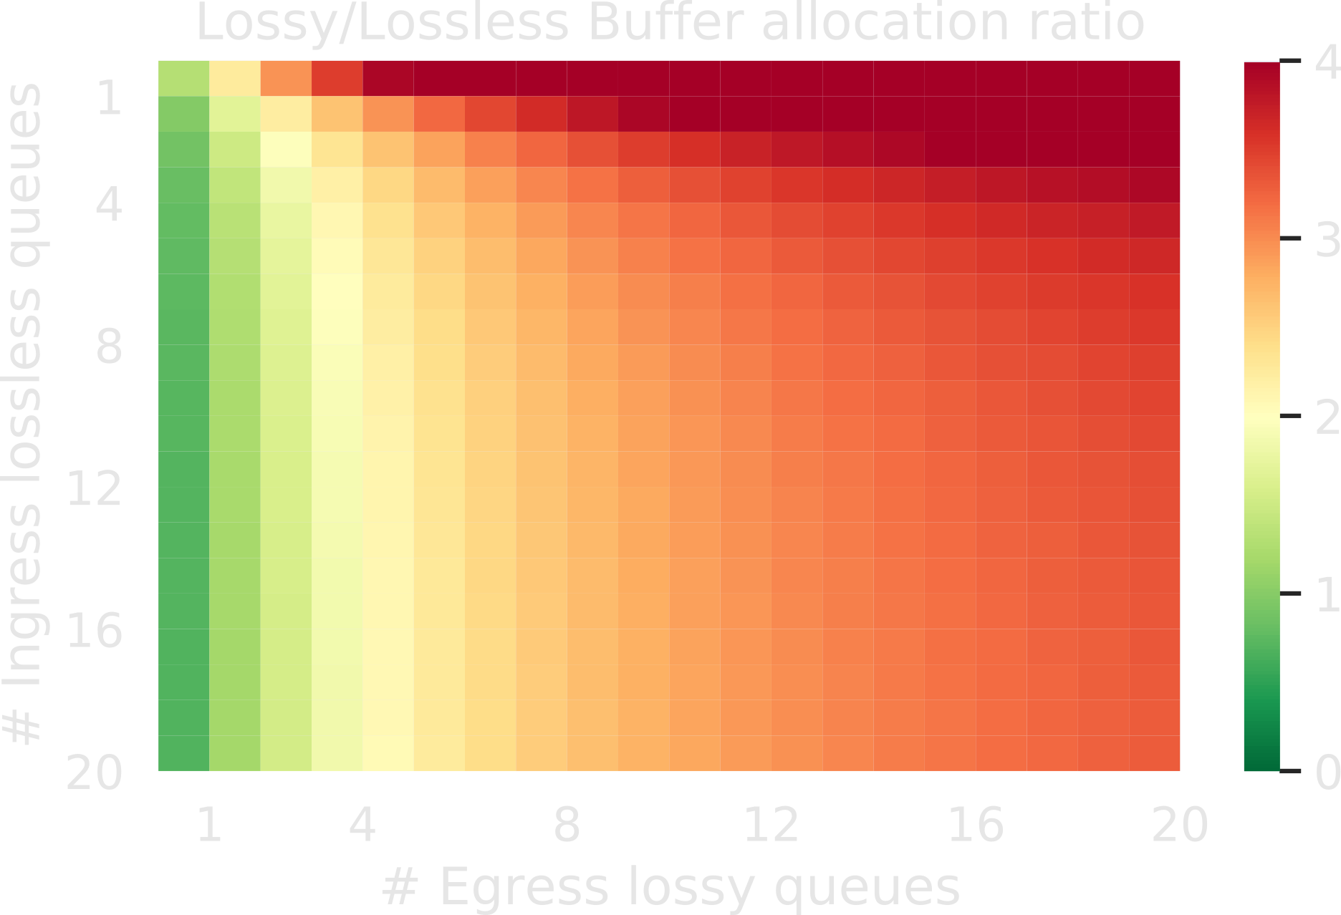
Problem 1: TCP Gets More Buffer than RDMA under Contention
RDMA
TCP

Slide 40
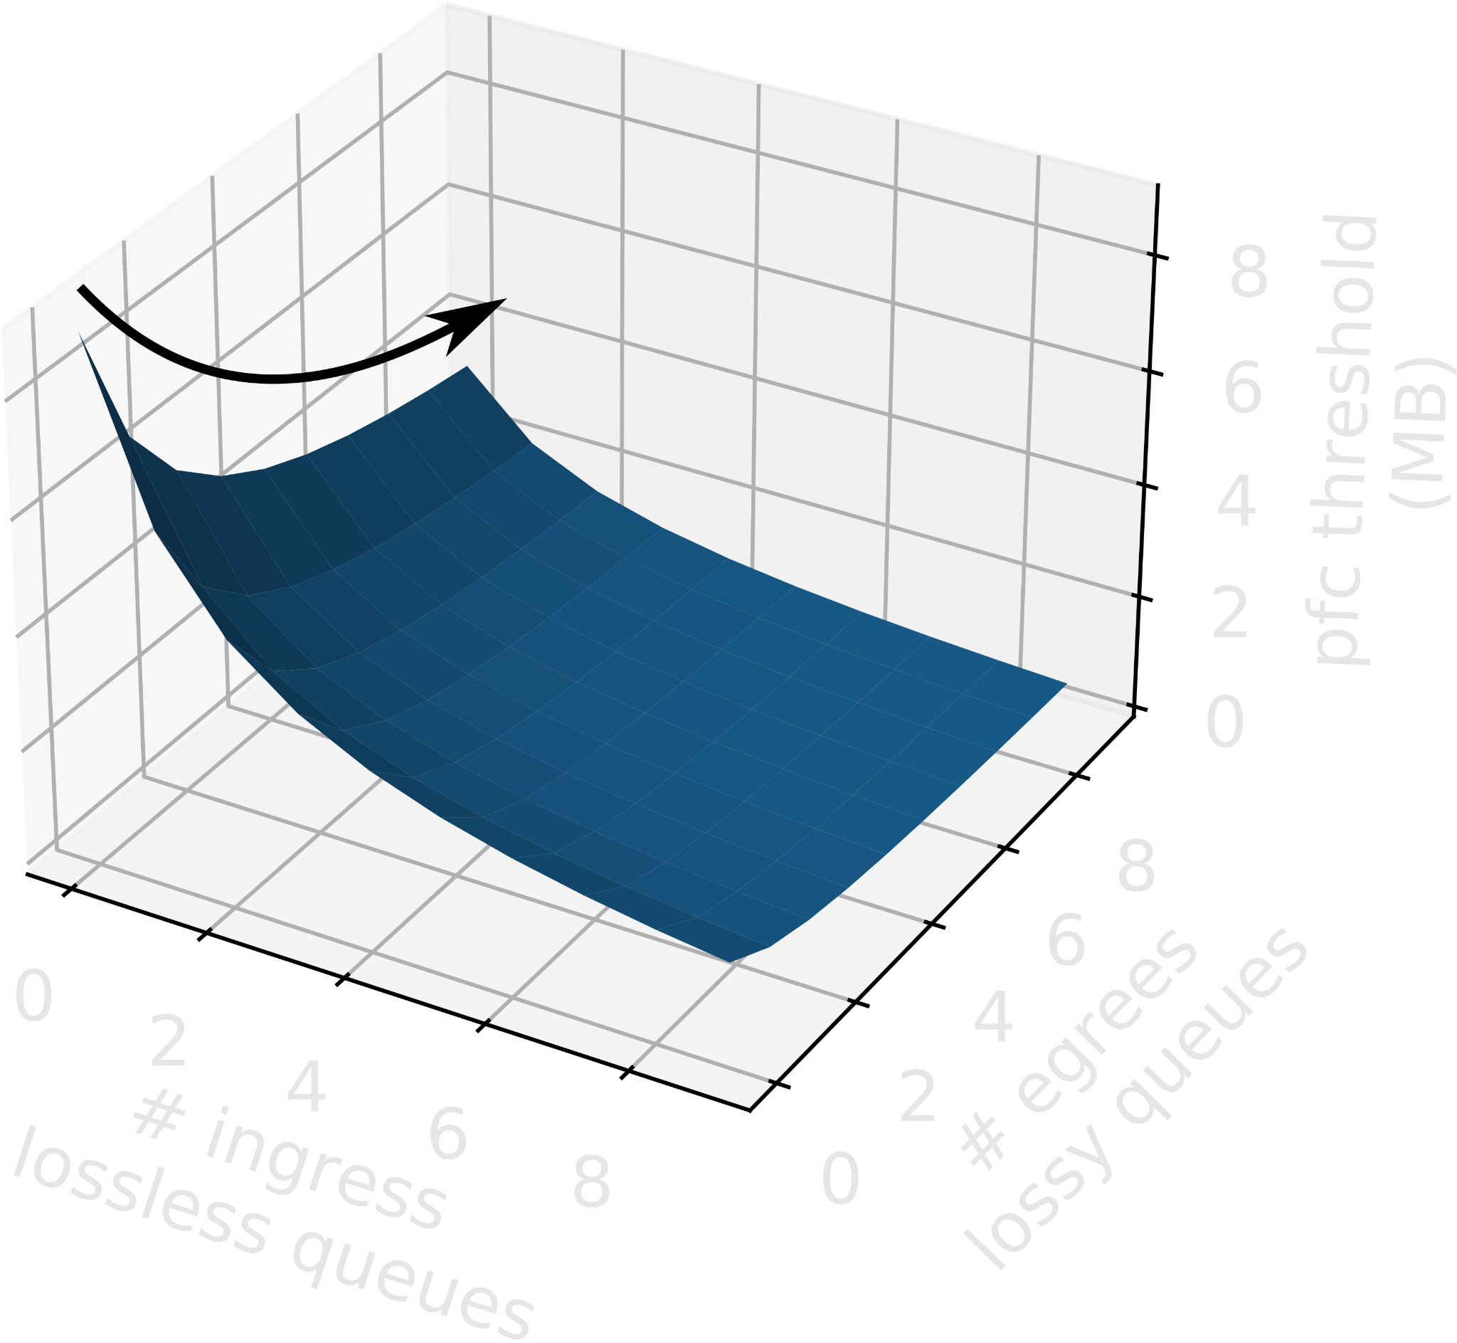
Problem 2: RDMA PFC Pause Due to TCP’s Buffer Occupancy
(TCP)
(RDMA)

Slide 41
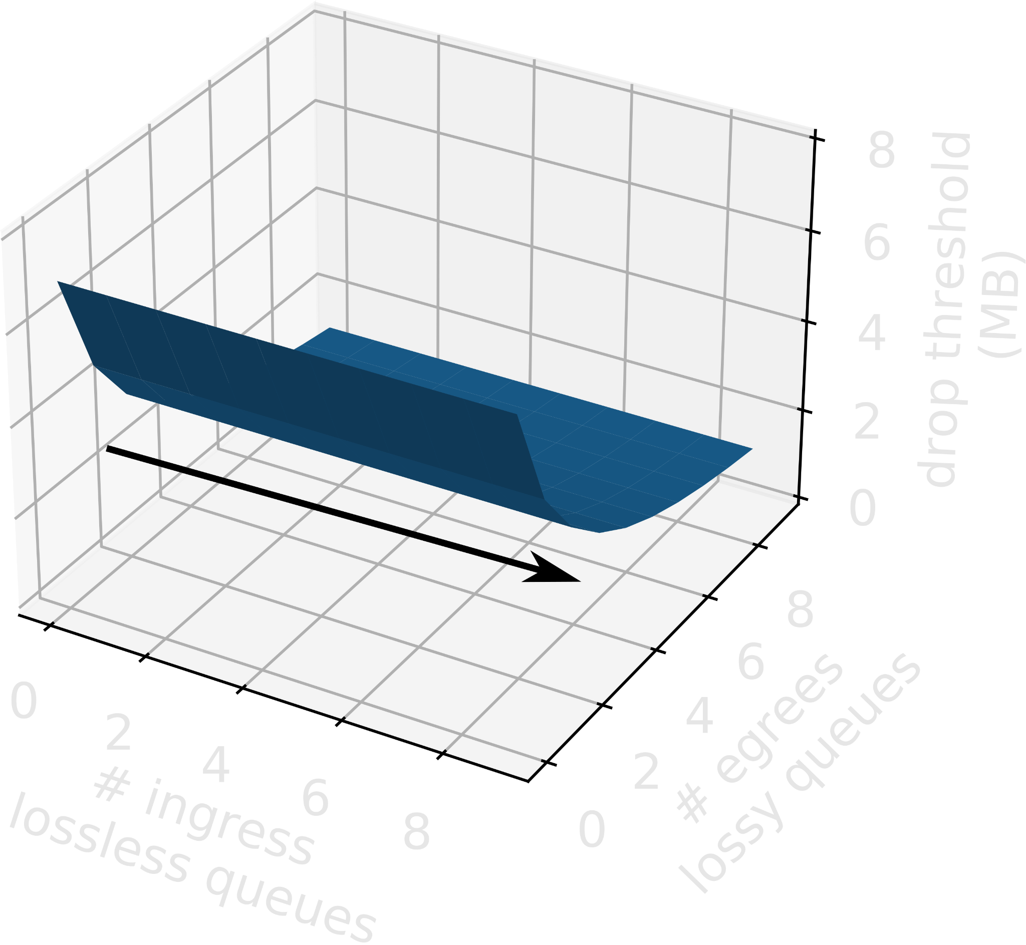
Problem 2: PFC Pause Due to TCP’s Buffer Occupancy
(TCP)
(TCP)
(RDMA)
(RDMA)

Slide 42
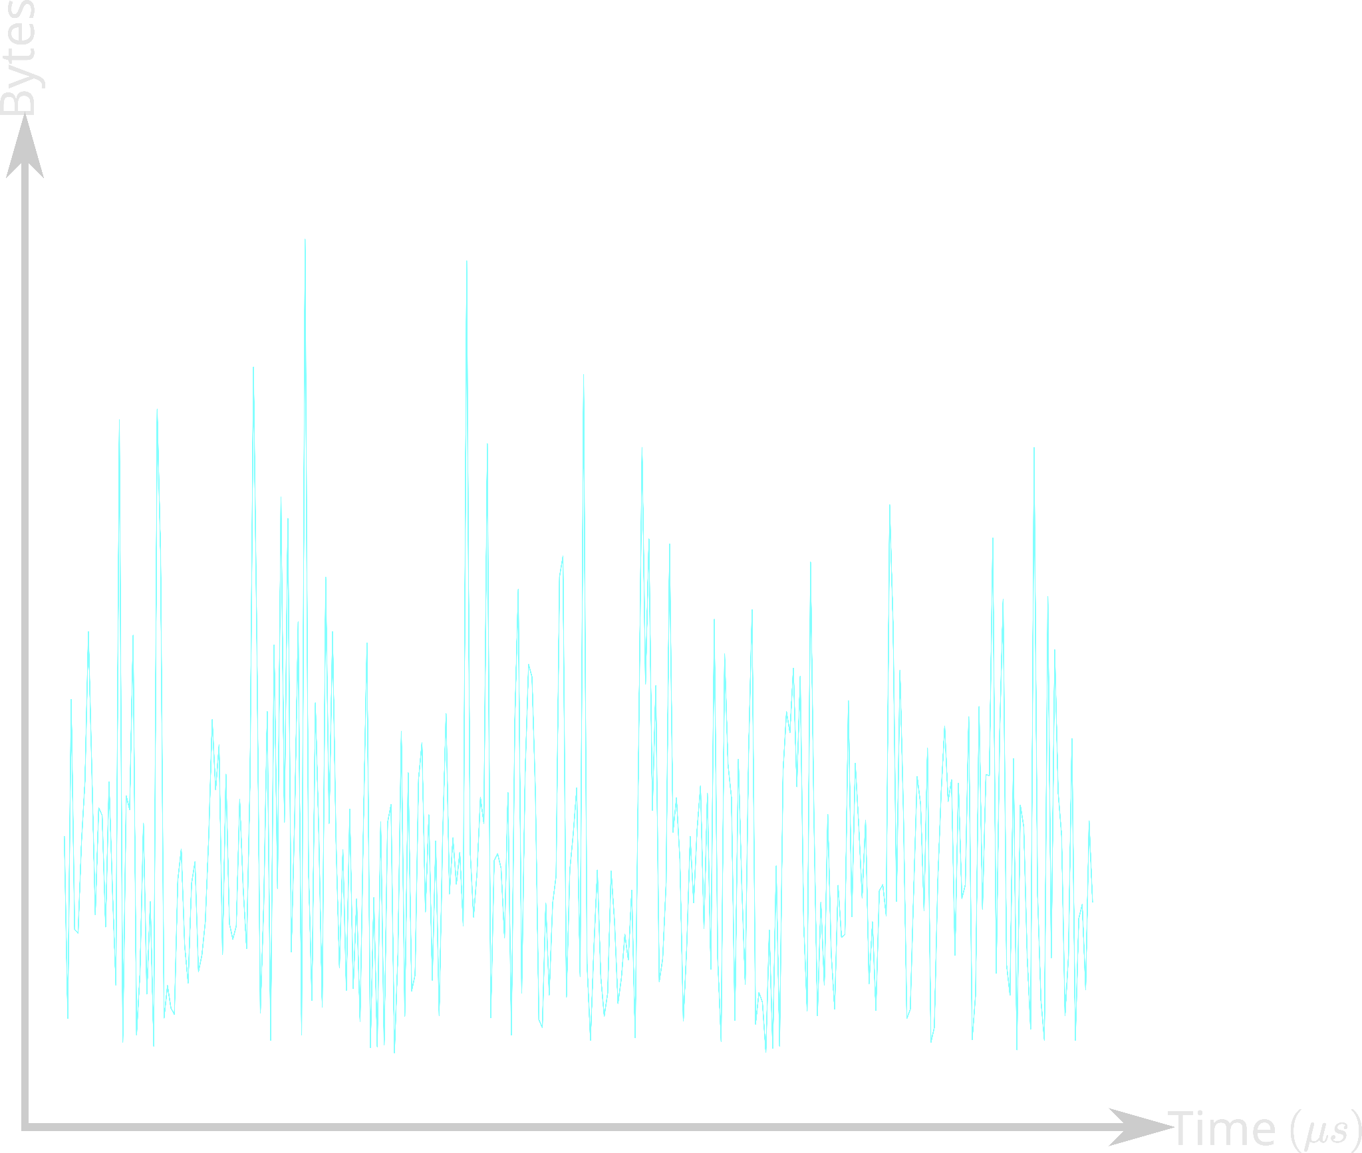
Problem 3: Poor Burst Absorption
Queue length

Slide 43
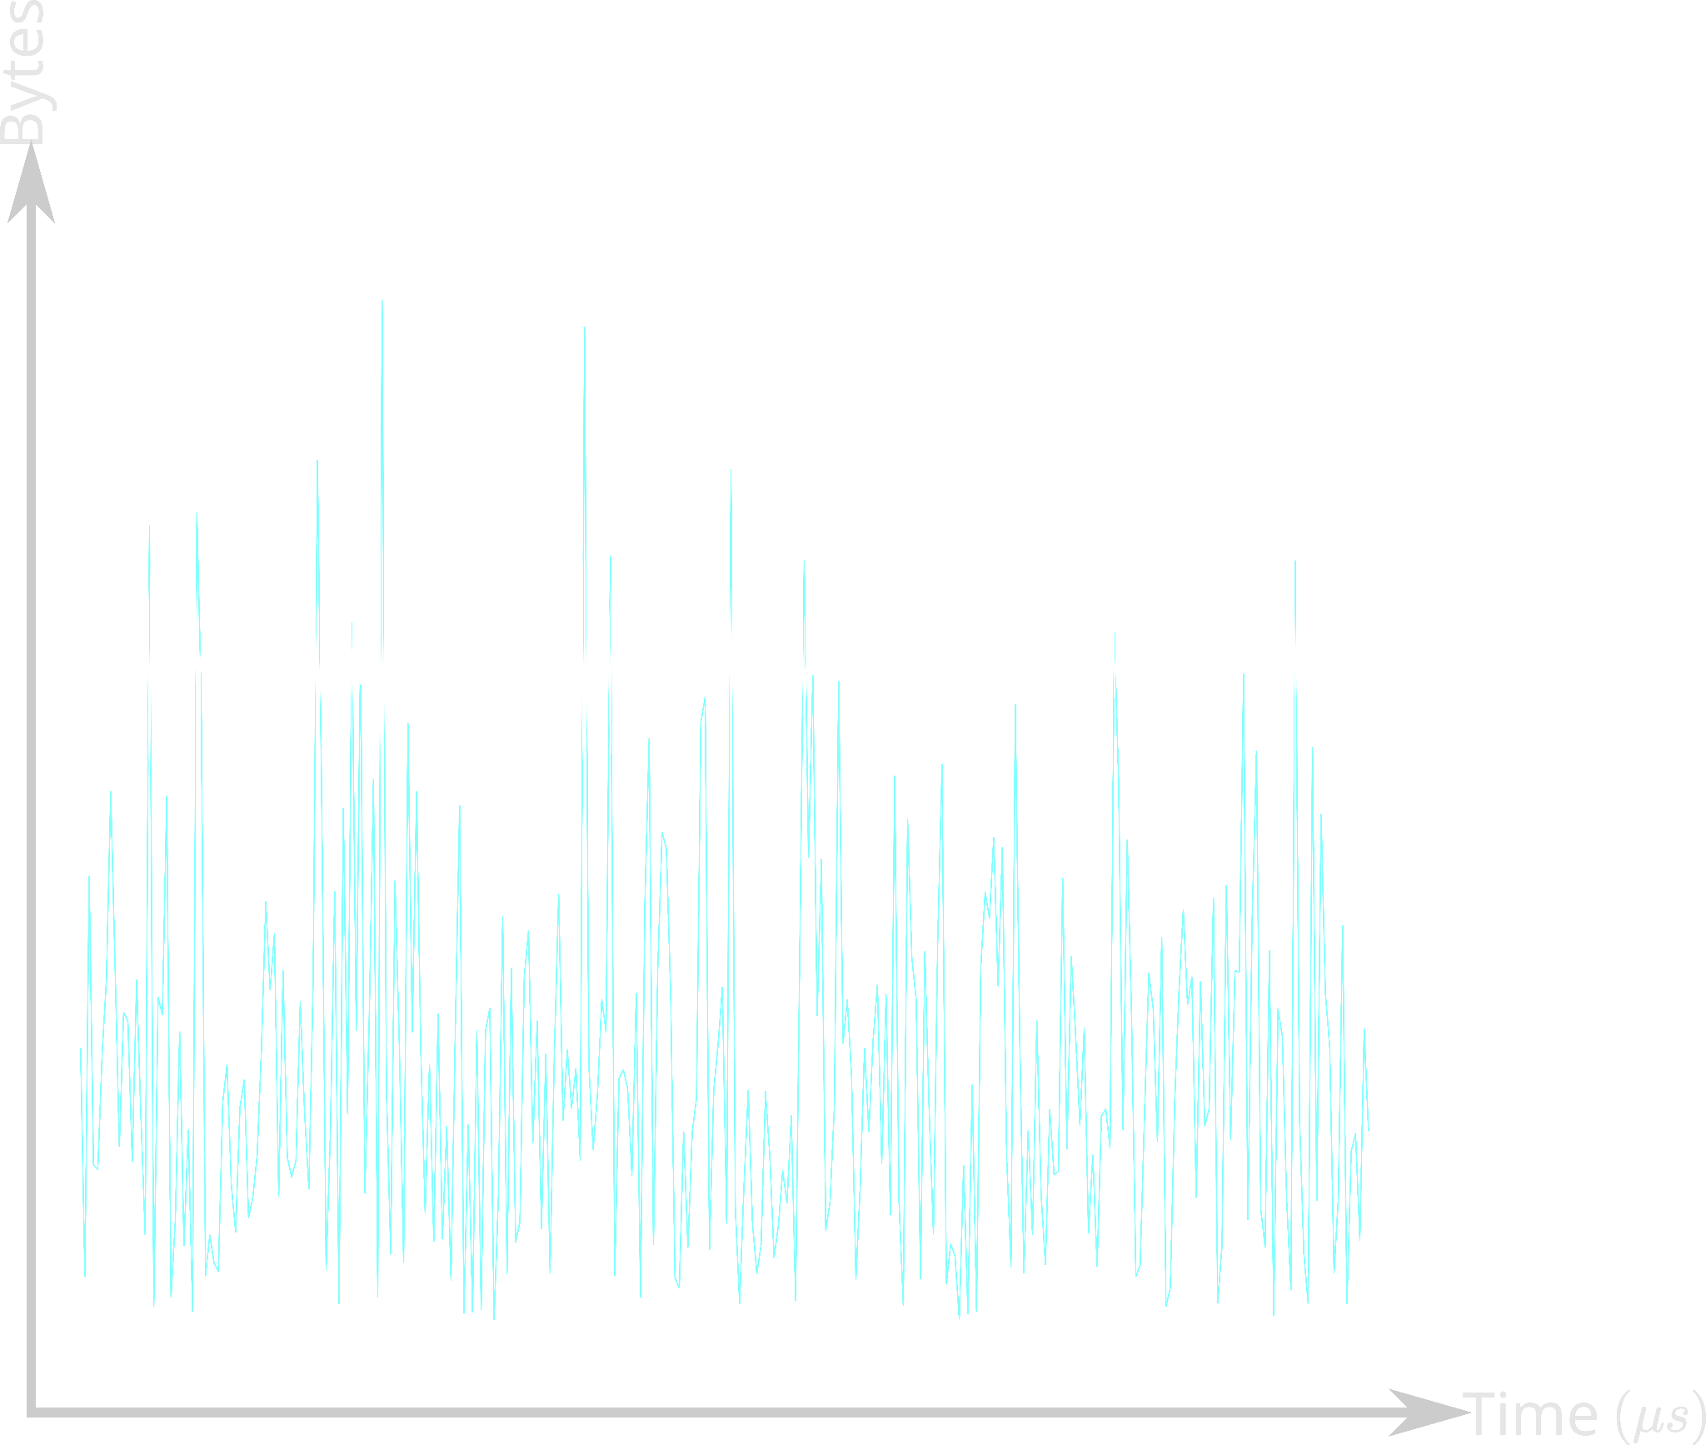
Problem 3: Poor Burst Absorption
Threshold
Queue length

Slide 44
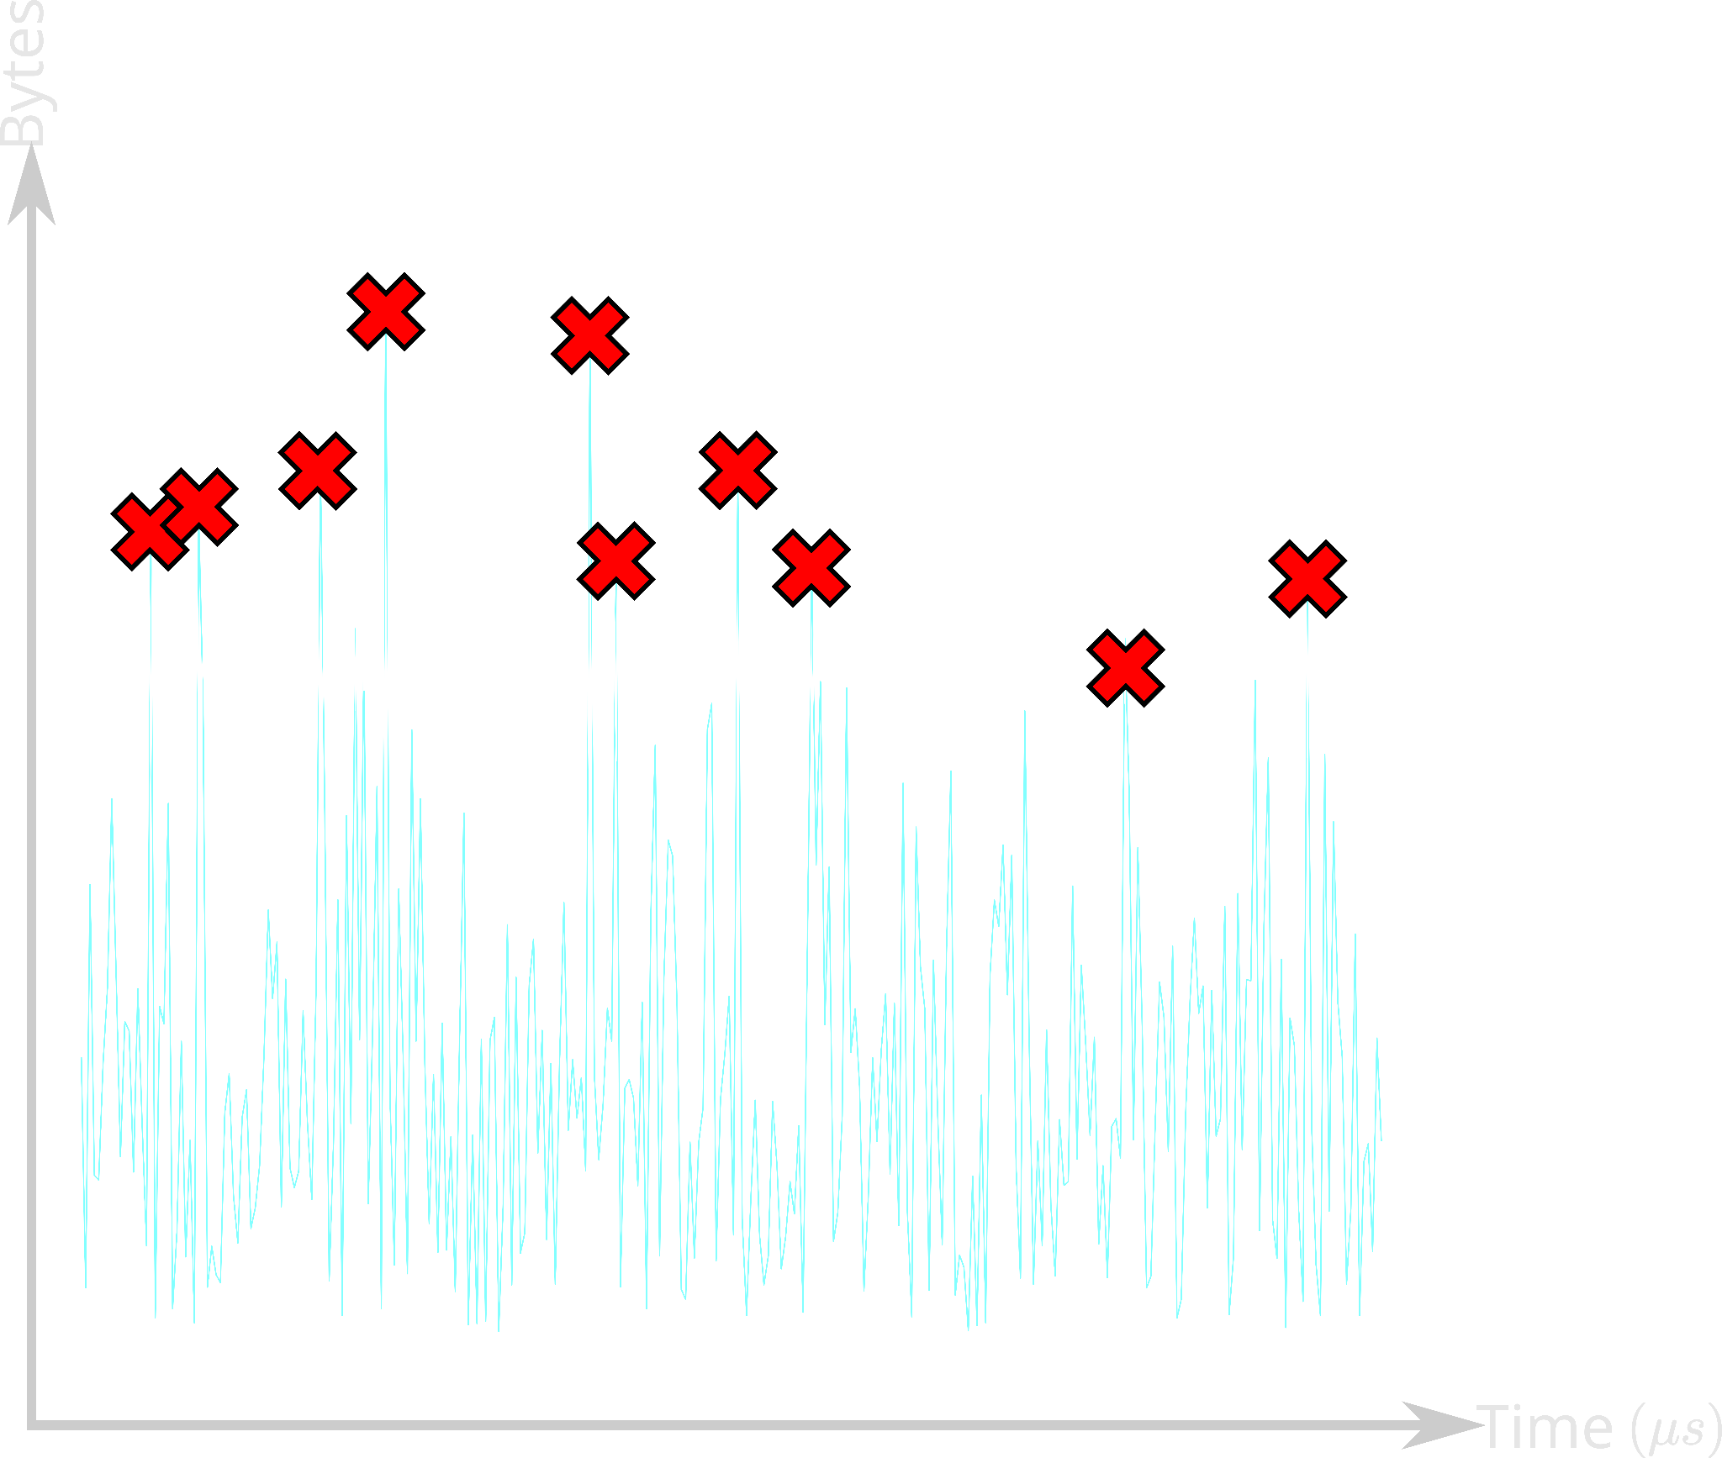
Problem 3: Poor Burst Absorption
Threshold
PFC or Drop
Queue length

Slide 45
Problem 3: Poor Burst Absorption
Threshold
PFC/Drop
Overreaction to transient state
Queue length

Slide 46
Can we isolate RDMA and TCP while improving burst absorption?

Slide 47
Reverie
Achieves isolation across RDMA and TCP
Improves burst absorption

Slide 48
Reverie
Single shared buffer pool for RDMA and TCP

Slide 49
Reverie
Single shared buffer pool for RDMA and TCP
Headroom
Egress Lossless
(RDMA)
Ingress
RDMA
+
TCP
Egress Lossy
(TCP)
Ingress
Egress

Slide 50
Reverie
Single shared buffer pool for RDMA and TCP
Headroom
RDMA
TCP
Shared pool

Slide 51
Reverie
Single shared buffer pool for RDMA and TCP
Consolidated ingress and egress buffer views
Birds-eye view of the buffer
Headroom
RDMA
TCP
Shared pool

Slide 52
Reverie
Single shared buffer pool for RDMA and TCP
Consolidated ingress and egress buffer views
Birds-eye view of the buffer
Headroom
Accounted only once
RDMA
TCP
Only ingress queues
Shared pool
Only egress queues

Slide 53
Reverie
Single shared buffer pool for RDMA and TCP
Consolidated ingress and egress buffer views
Birds-eye view of the buffer
Headroom
RDMA
TCP
Thresholds govern the allocation across RDMA and TCP
Shared pool

Slide 54
Reverie
Threshold: 𝛂_{p} 🗙 (Remaining shared pool) 🗙 1
n_{p}
Configurable parameter for each queue
e.g., 𝛂_{r} for RDMA (ingress queues) and
𝛂_{t} for TCP (egress queues)

Slide 55
Reverie
Threshold: 𝛂_{p} 🗙 (Remaining shared pool) 🗙 1
n_{p}
Shared pool size — total shared occupancy

Slide 56
Reverie
Threshold: 𝛂_{p} 🗙 (Remaining shared pool) 🗙 1
n_{p}
Number of congested queues of type p

Slide 57
Reverie
Threshold: 𝛂_{p} 🗙 (Remaining shared pool) 🗙 1
n_{p}
RDMA vs TCP
Isolation ✅
Fair allocation ✅

Slide 58
Reverie
Single shared buffer pool for RDMA and TCP
Consolidated ingress and egress buffer views
Birds-eye view of the buffer
Low pass filter-based admission control
High burst absorption

Slide 59
Reverie
Threshold
PFC/Drop
Overreaction to transient state
Queue length

Slide 60
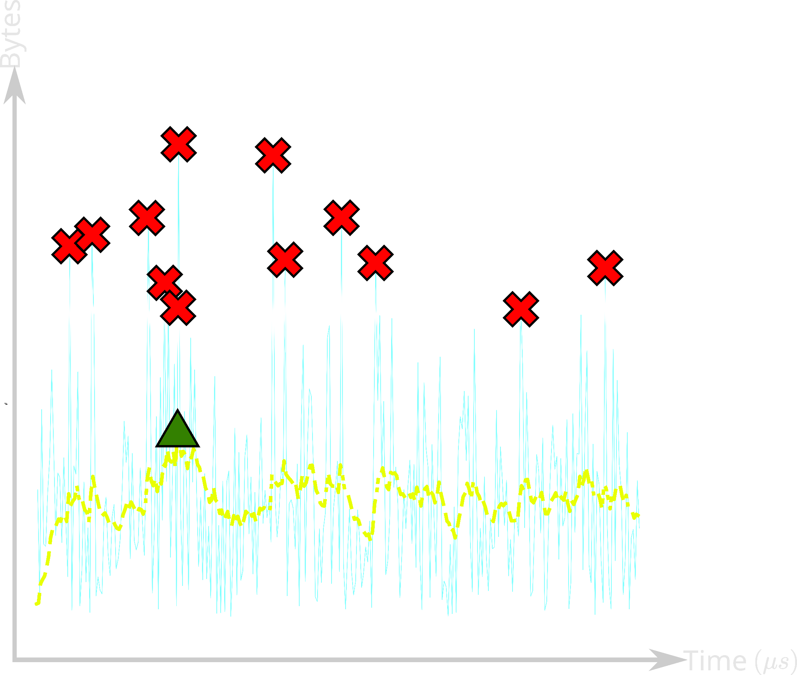
Reverie
Threshold
Queue length
Low-pass filtered Queue length

Slide 61
Reverie
Threshold
PFC/Drop
Smooth reaction to transient state
Low-pass filtered Queue length

Slide 62
Reverie’s properties
Fair allocation across RDMA and TCP
Steady-state isolation
Improved burst absorption
(Formal proofs in the paper)

Slide 63
Evaluation
Packet-level simulations using NS3
256 servers, 4 spine switches and 16 ToR switches
25Gbps NICs
Websearch workload + Synthetic incast workload
Shared buffer at the switches
Dynamic Thresholds (SONiC model)
ABM (SONiC model)
Reverie

Slide 64
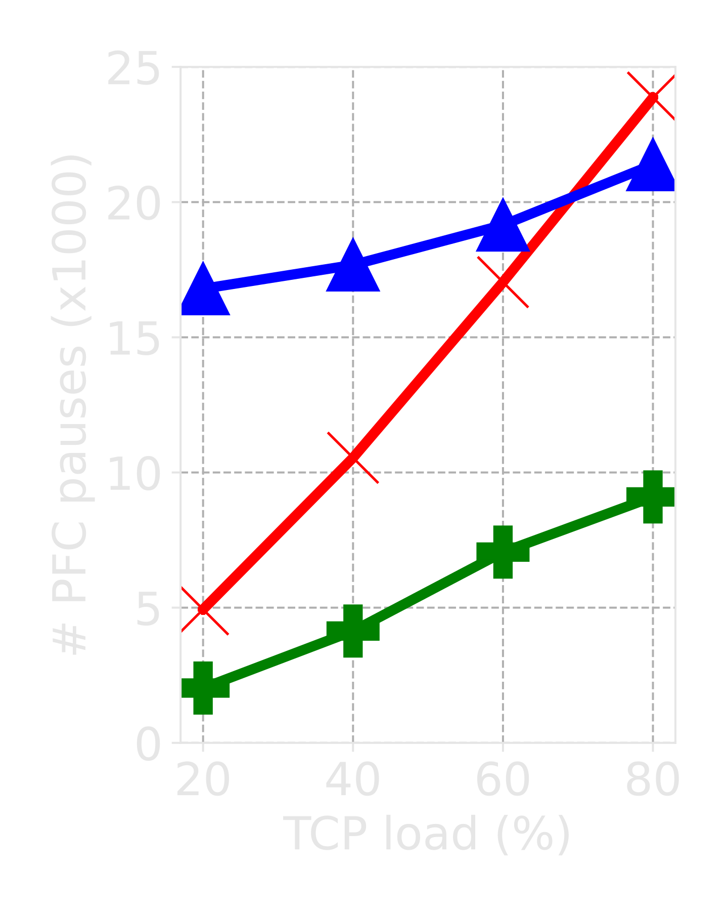
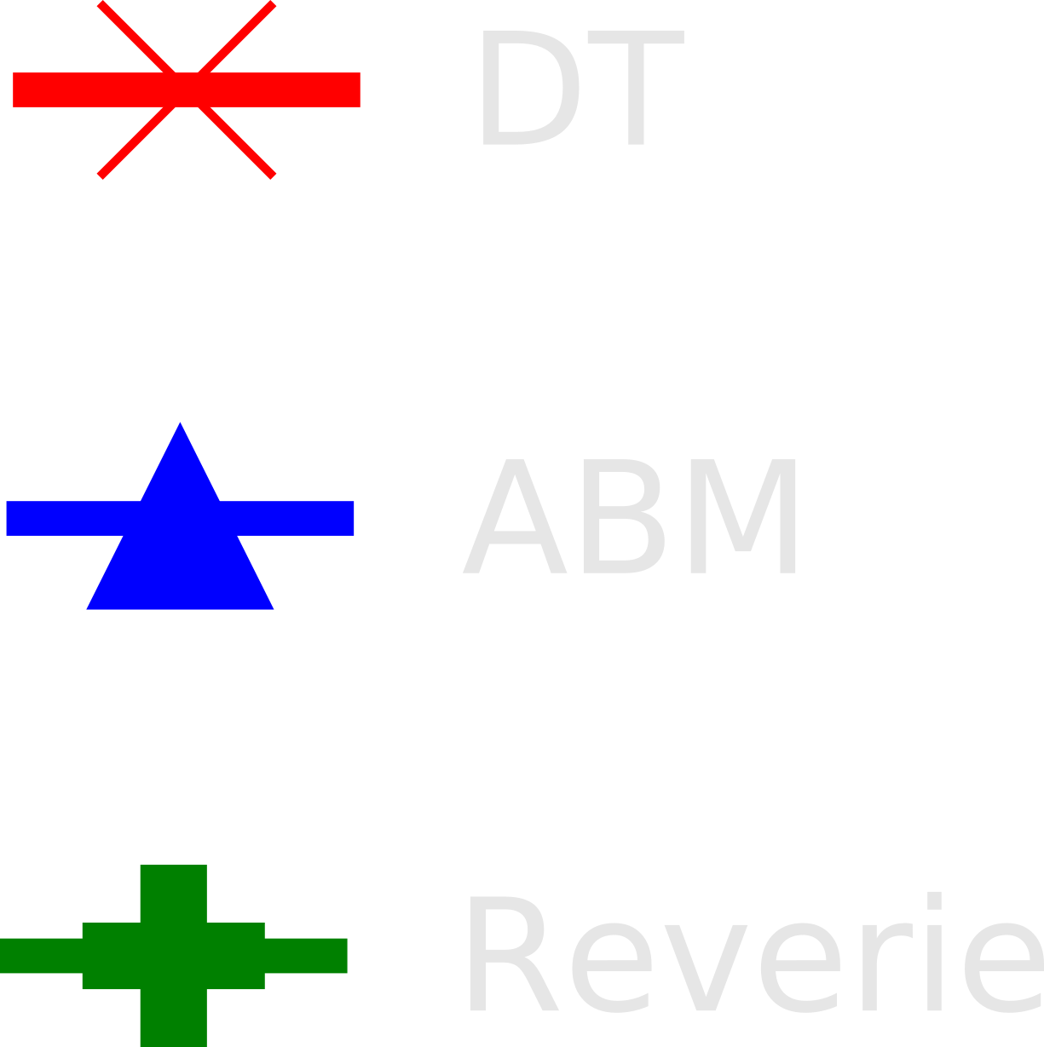
Reverie Reduces the Interactions Between TCP and RDMA
Better

Slide 65
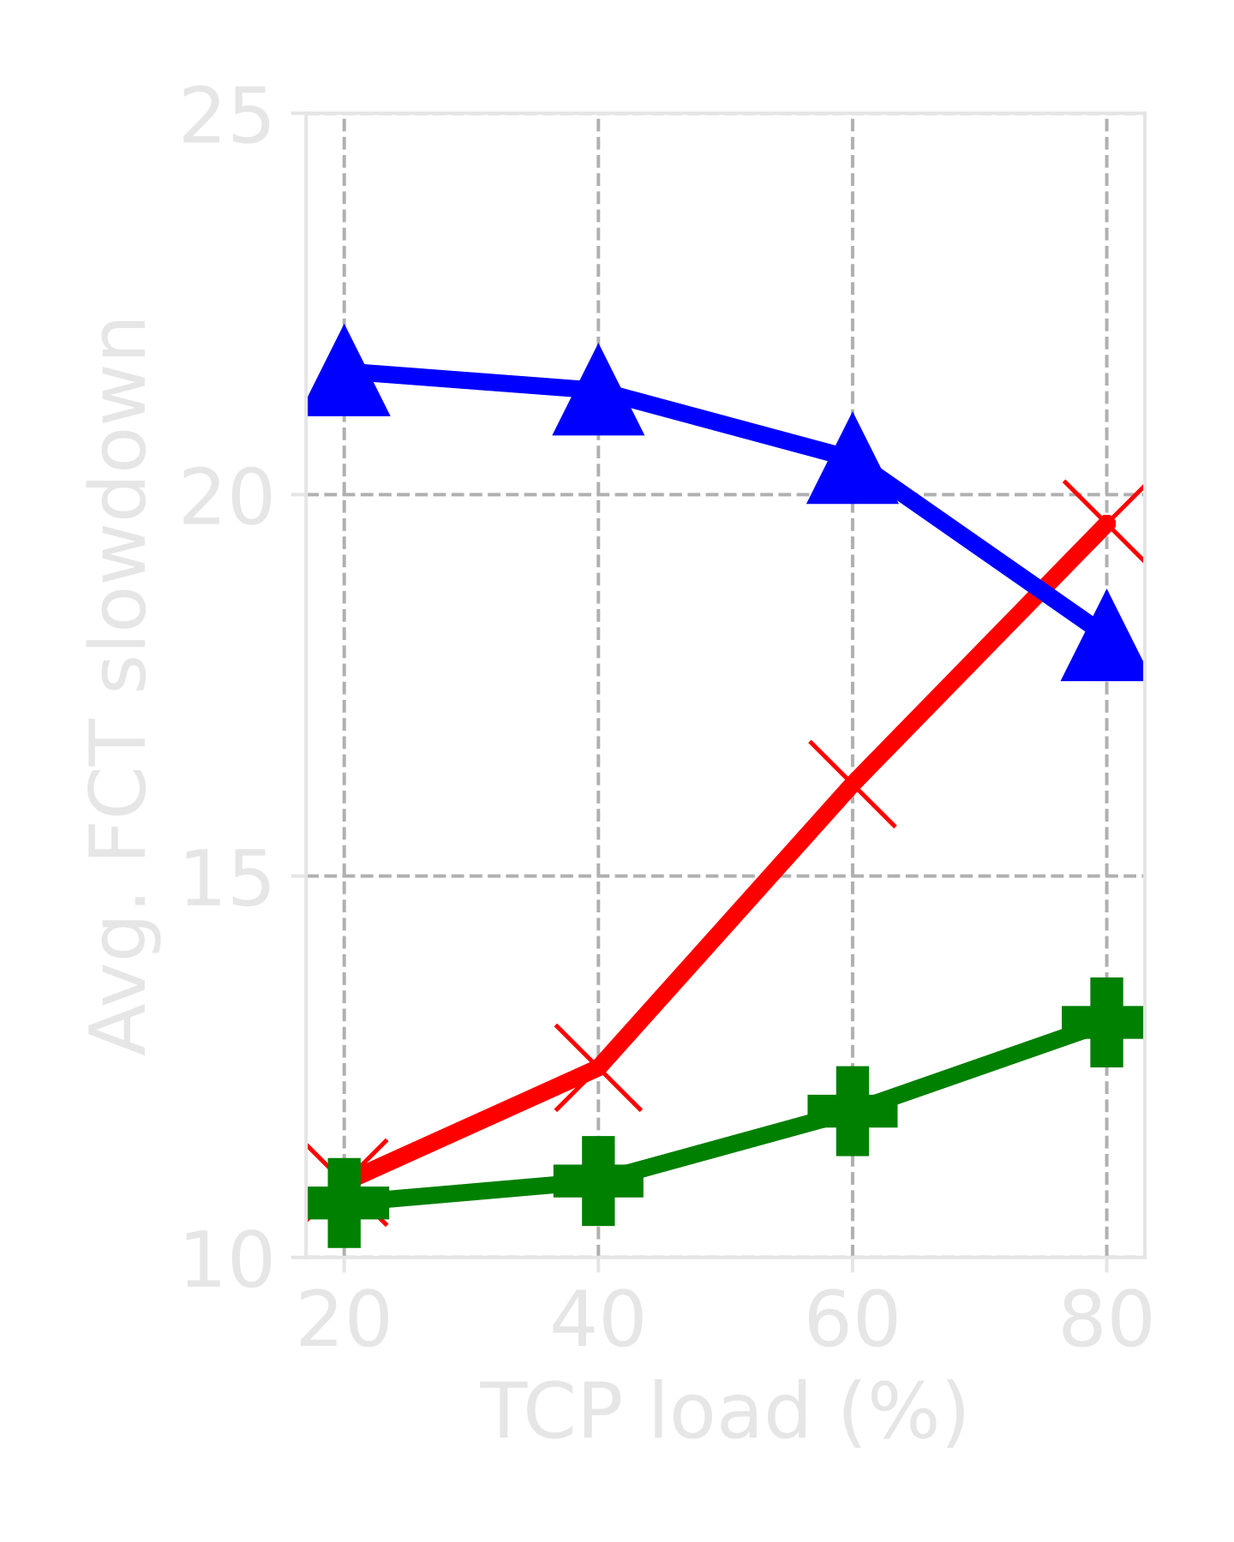
Reverie Improves Burst Absorption for RDMA
Better

Slide 66
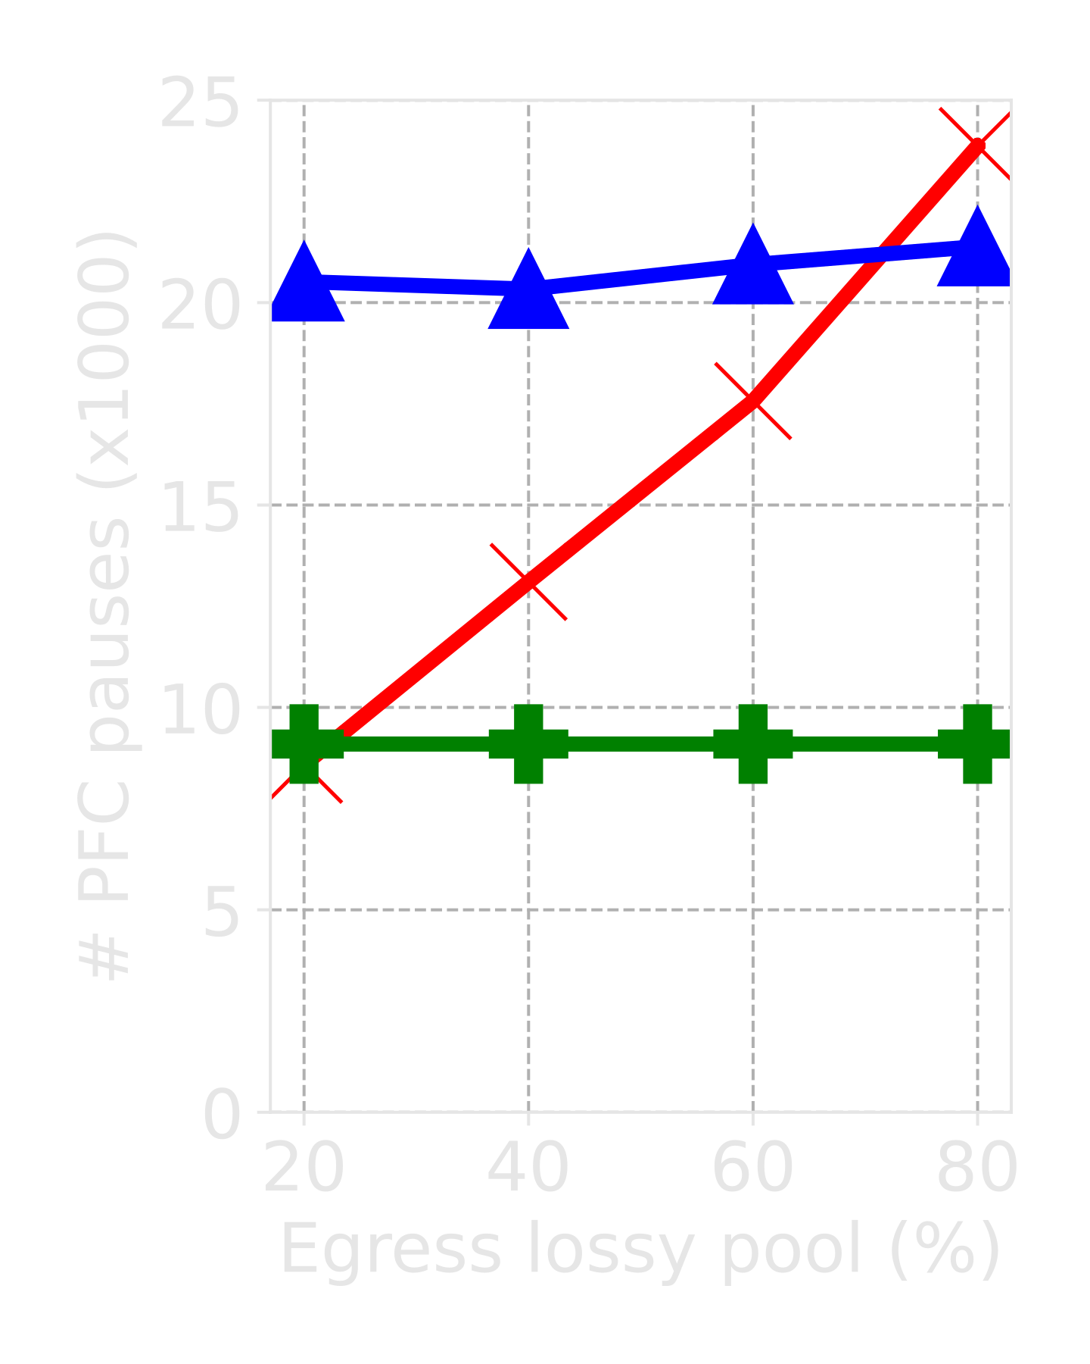
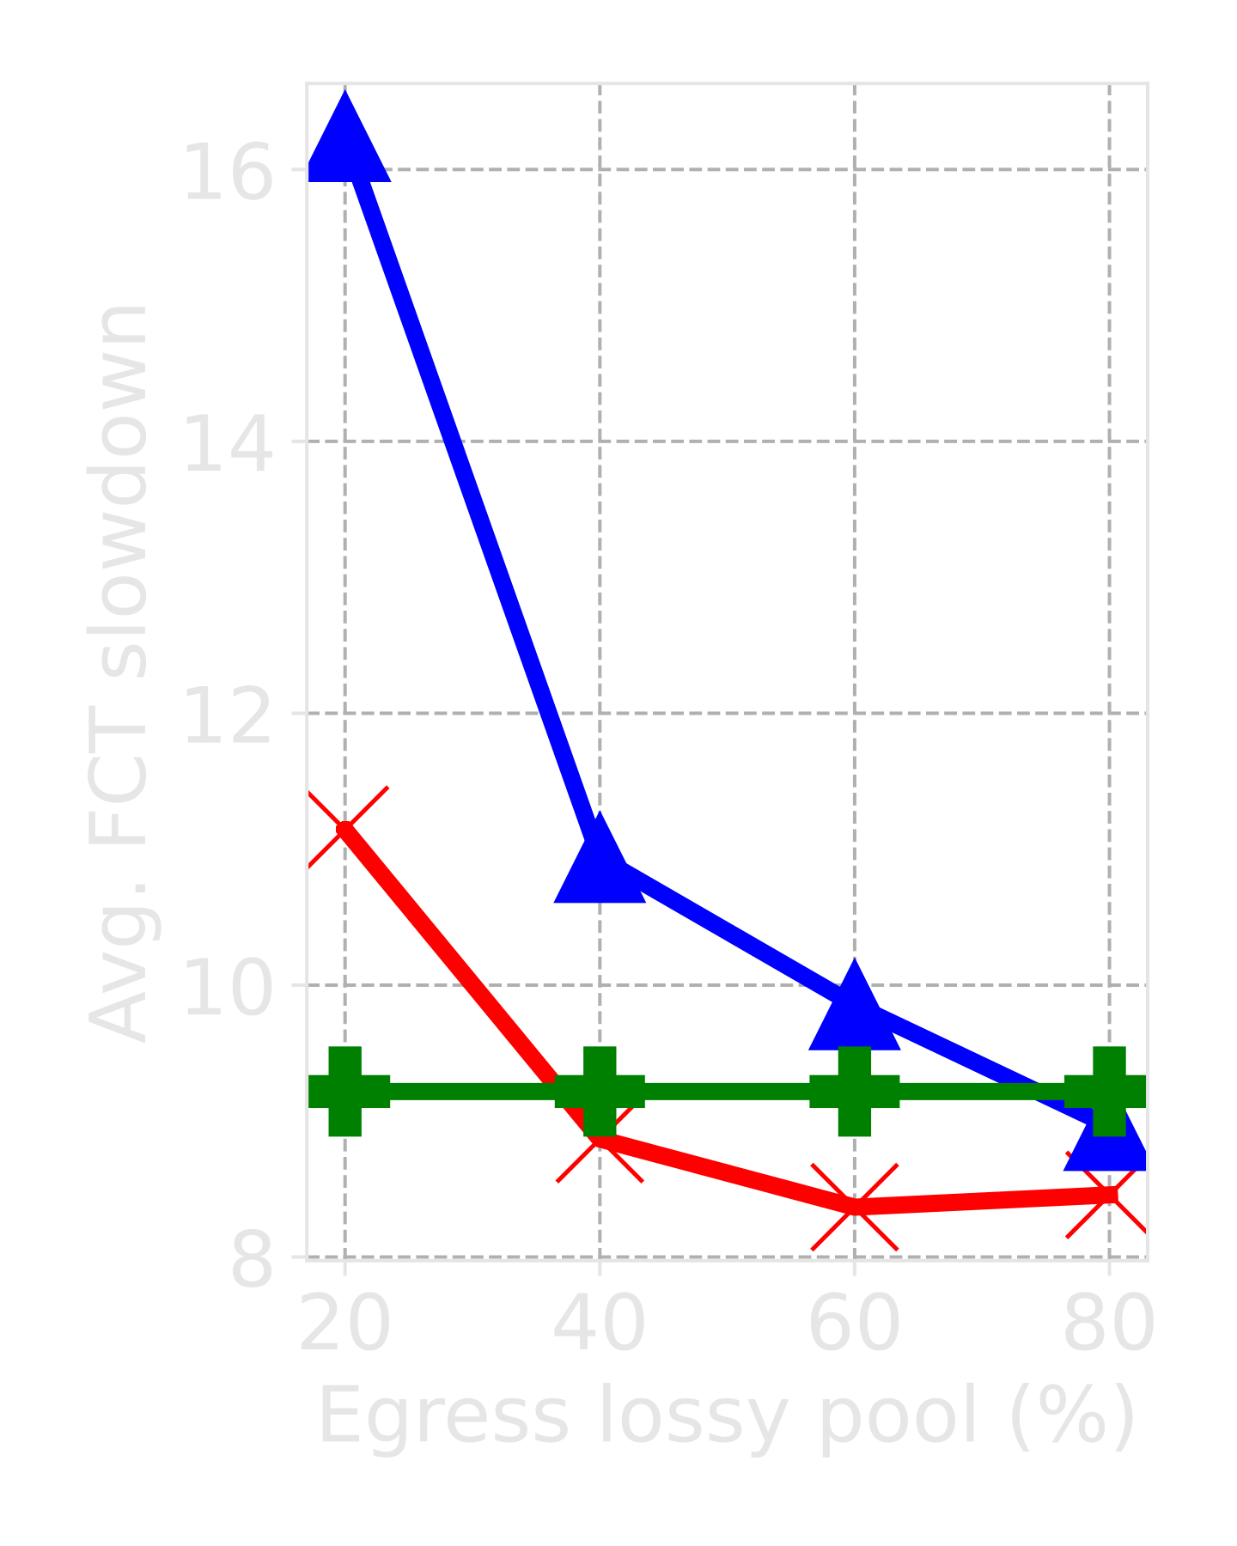
Reverie Improves the Performance of both RDMA and TCP
RDMA
TCP
Better
Better

Slide 67
Conclusion
Existing buffer sharing techniques cannot serve the diverse buffer needs of RDMA and TCP
Reverie achieves isolation between RDMA and TCP
Reverie improves burst absorption for RDMA and TCP
Reverie improves flow completions for RDMA and TCP
Source code: https://github.com/inet-tub/ns3-datacenter

Slide 68
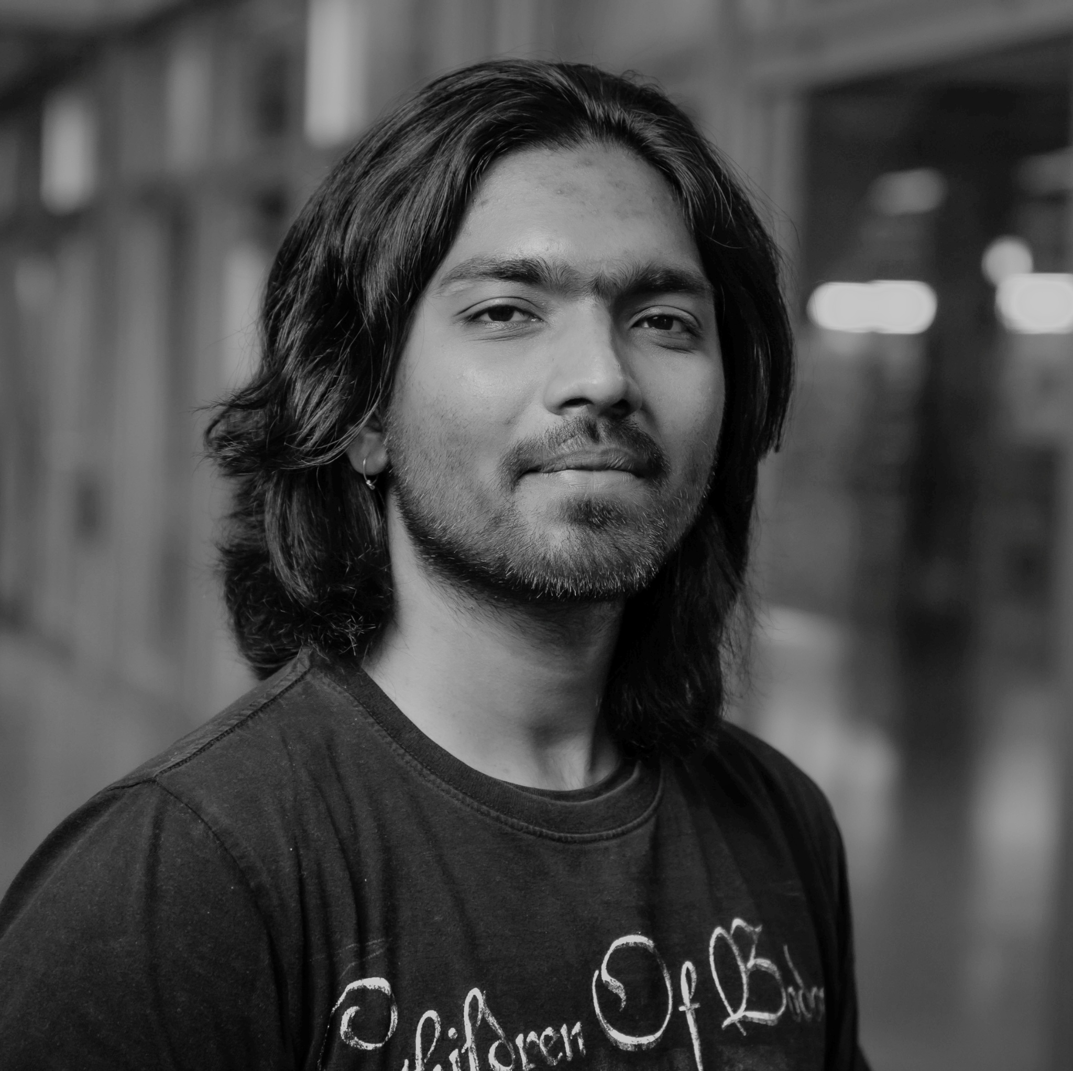
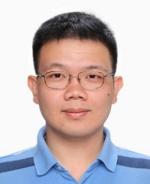
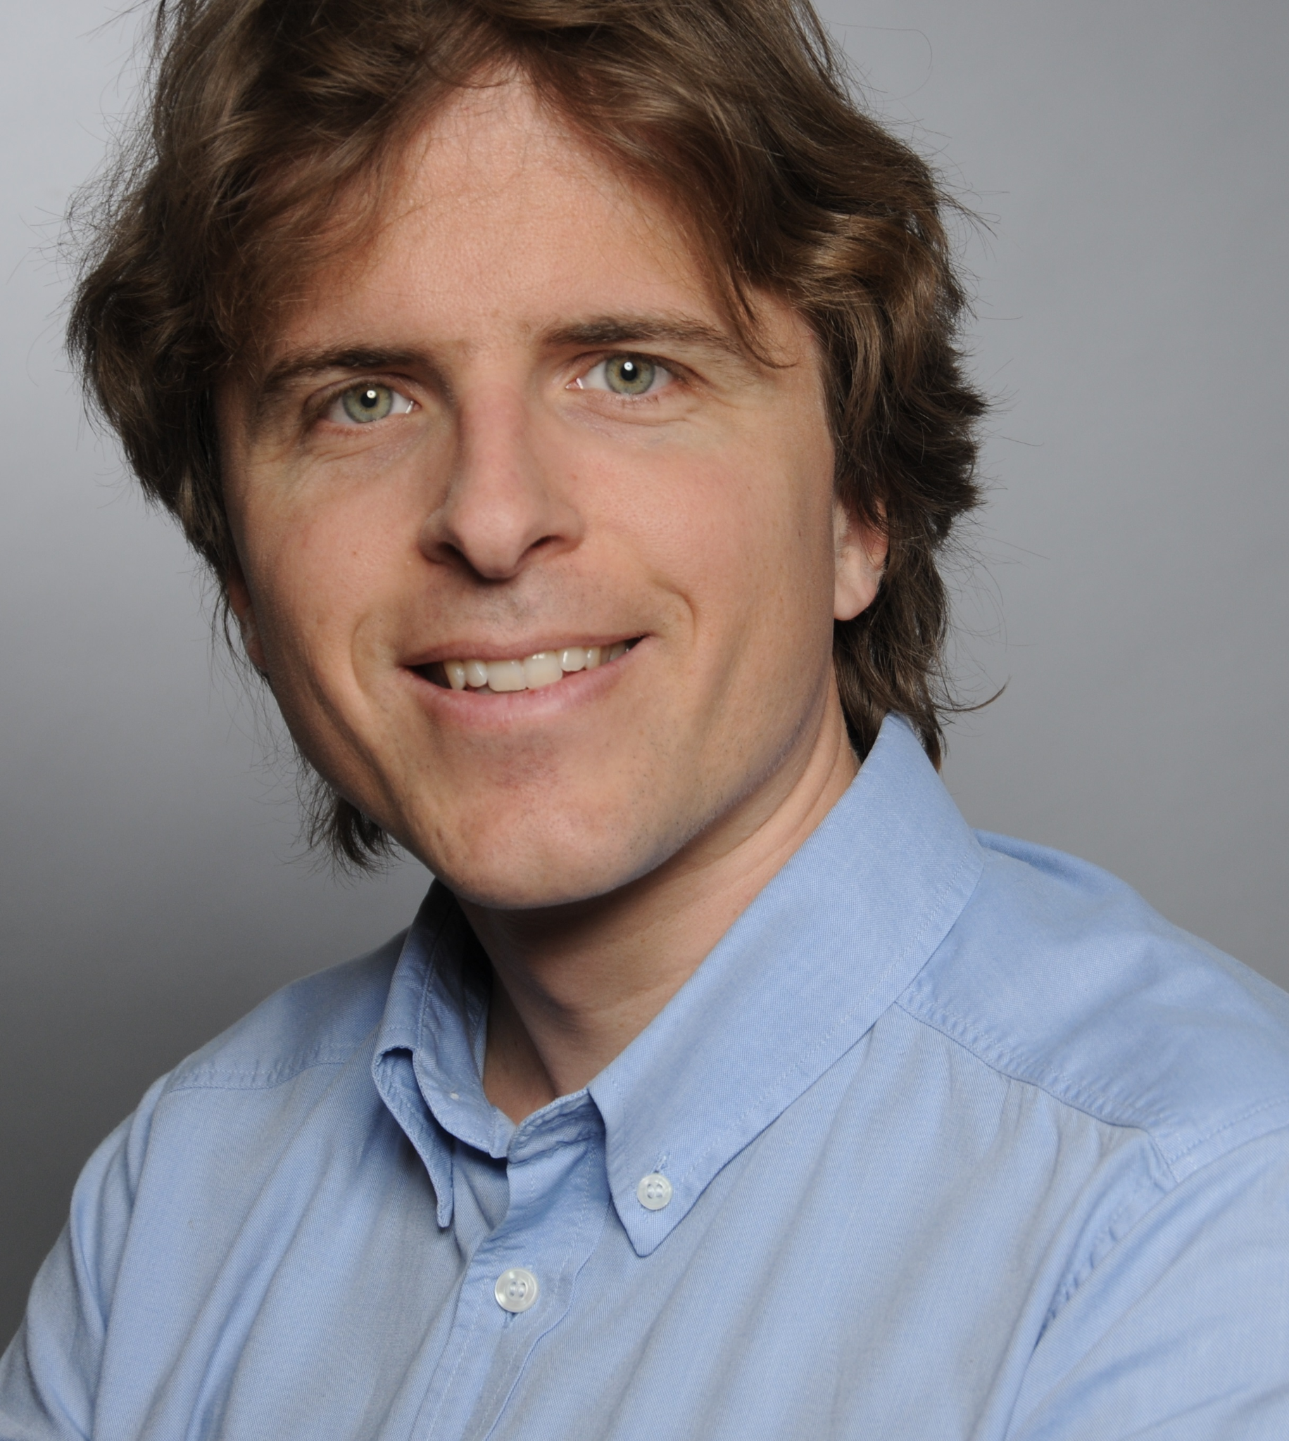
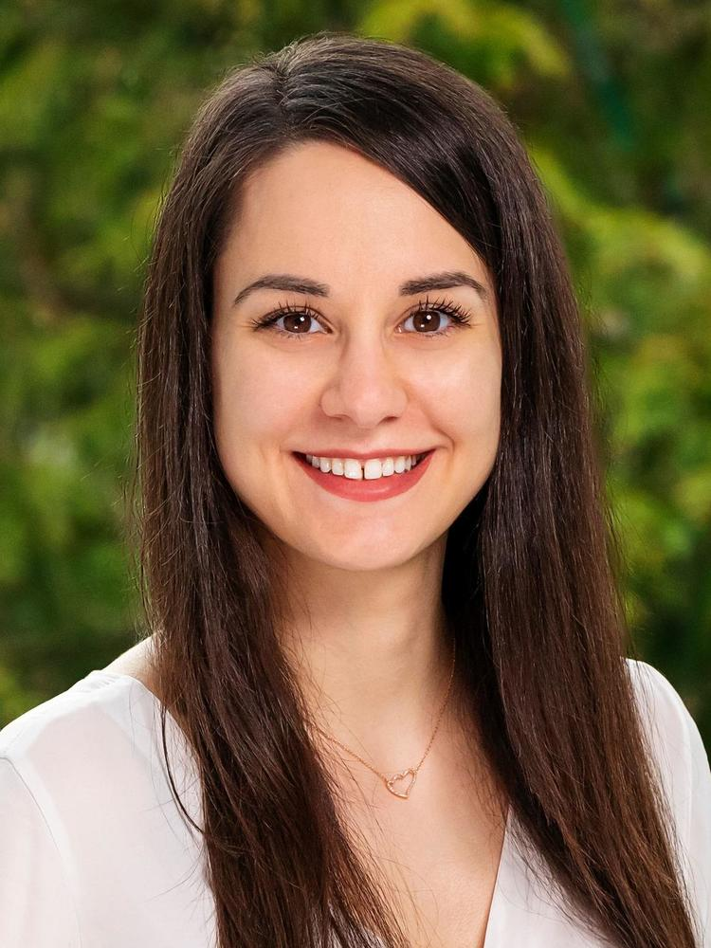

Vamsi Addanki
vamsi@inet.tu-berlin.de
@Vamsi_DT
Wei Bai
wbai@nvidia.com
@baiwei96642217
Stefan Schmid
stefan.schmid@tu-berlin.de
@schmiste_ch
Maria Apostolaki
apostolaki@princeton.edu
@maria__apo
Thank You

